Slide 1
Problem statement;
The goal is to create a web application using Flask framework to manage a small petty shop where there are items, purchases and sales. This website contains:
Login page
Home page
Purchase items
Sales

Slide 2
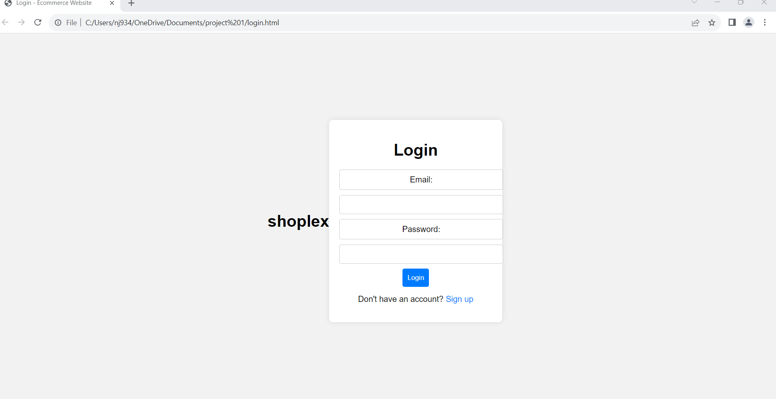
Login page:

Slide 3
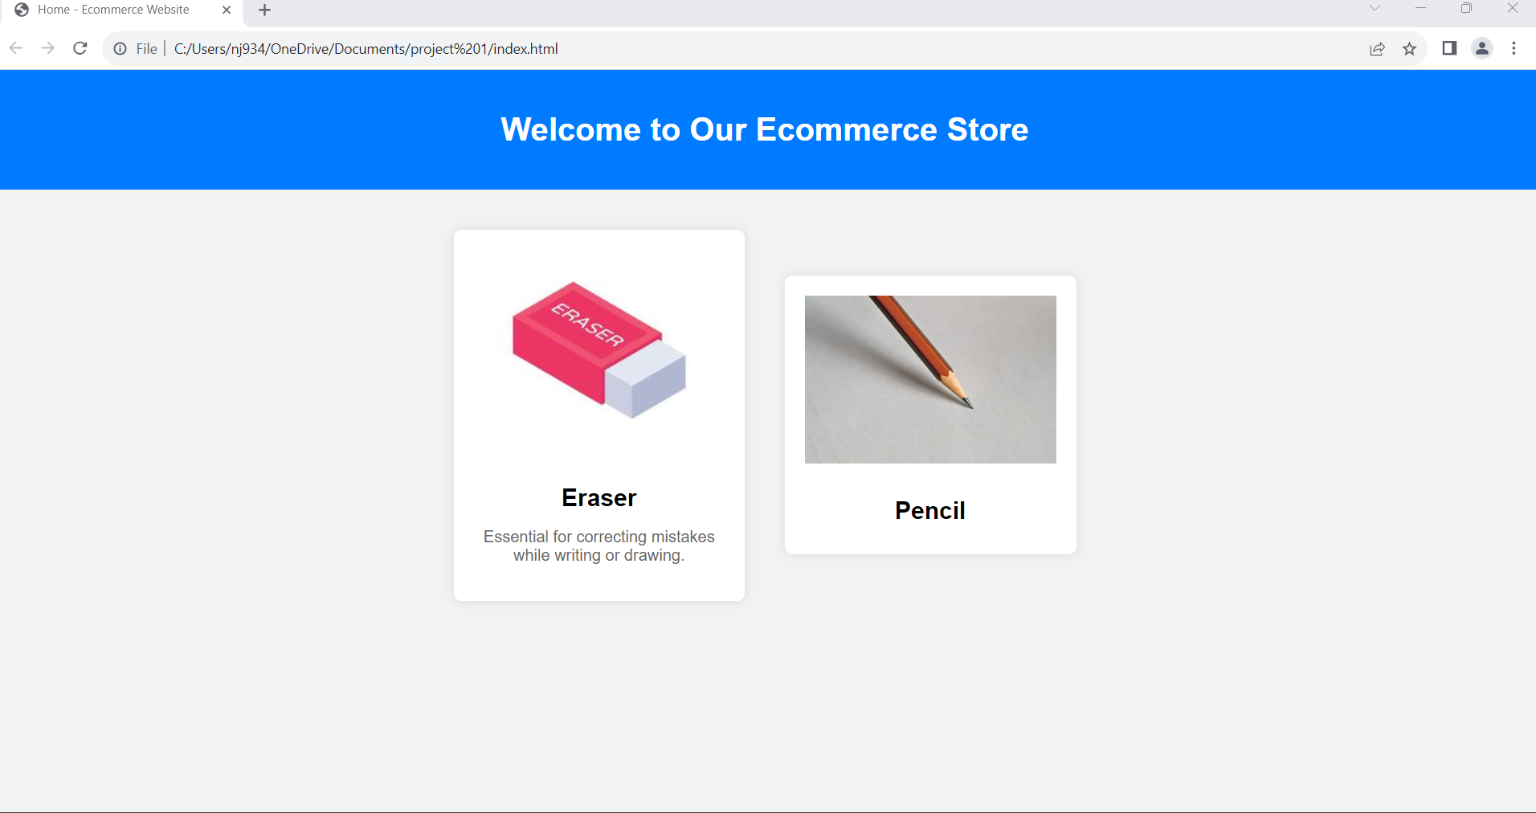
HOME PAGE:

Slide 4
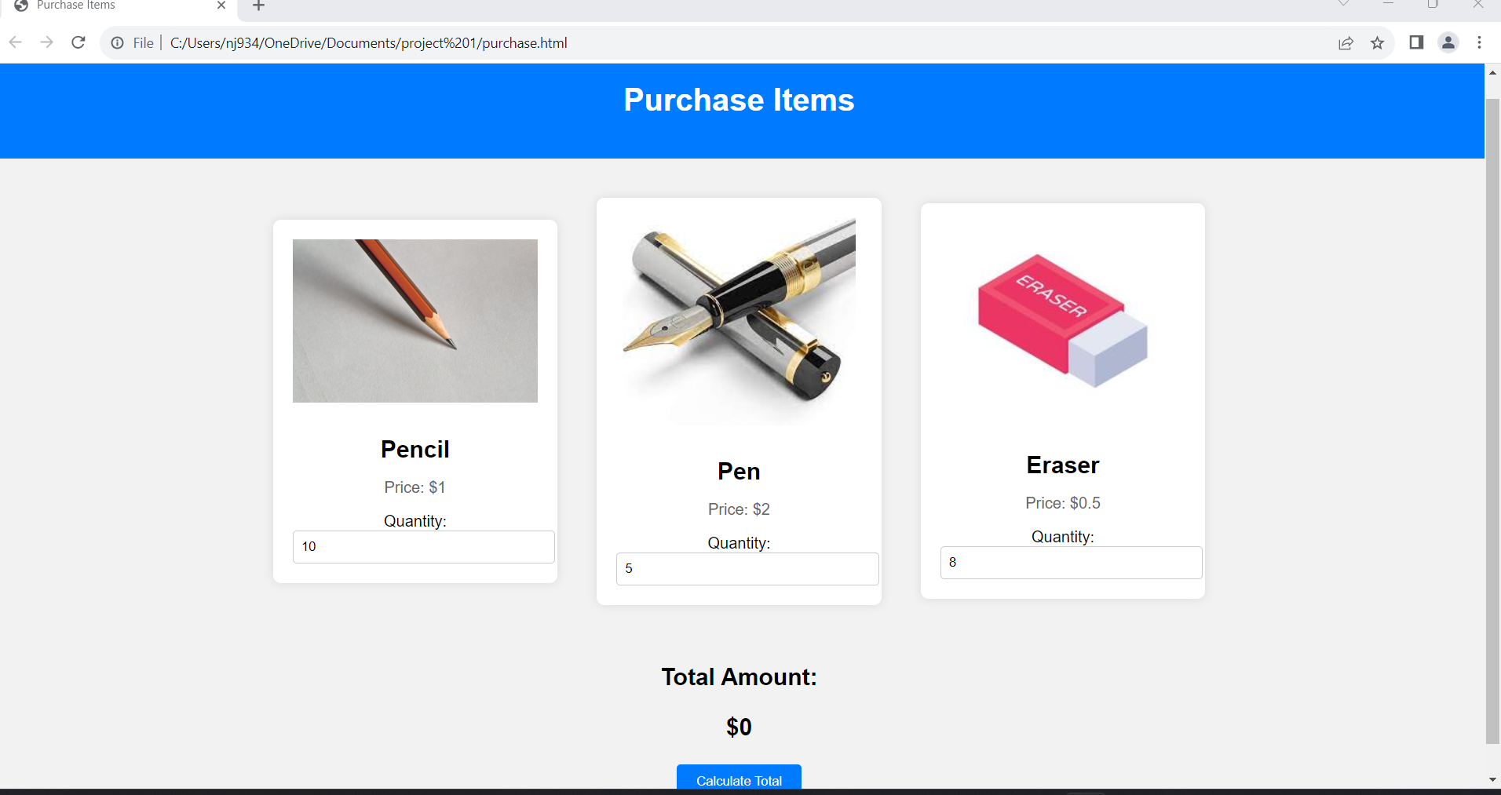
PURCHASE ITEMS:

Slide 5
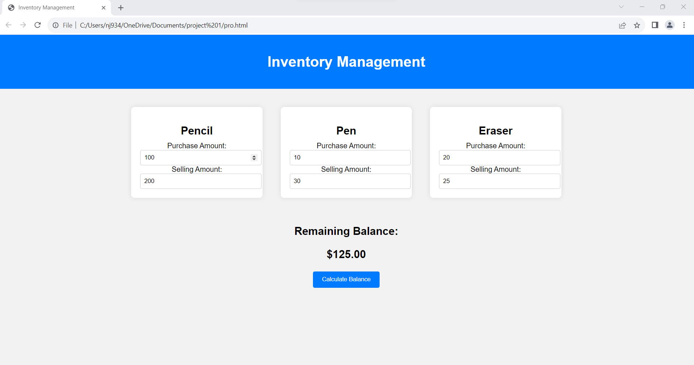
INVENTORY MANAGEMENT:

